Slide 1

Servos

Slide 2
Reminder: Coding Club tomorrow !
(and every Thursday – same room)

Slide 3
What is a servo?
A servo is a device that uses feedback to control the position, speed, or motion of a mechanical component. It typically consists of a motor, a control circuit, and a position sensor, allowing it to move to a specific angle or position with high precision. Servos are commonly used in robotics, remote-controlled vehicles, and automation systems.
A servo is a motor that can move to a specific position or angle. It uses a sensor to know where it is and a controller to adjust its movement. You’ll find them in toys, robots, and machines.
More complicated definition
Less complicated definition

Slide 4
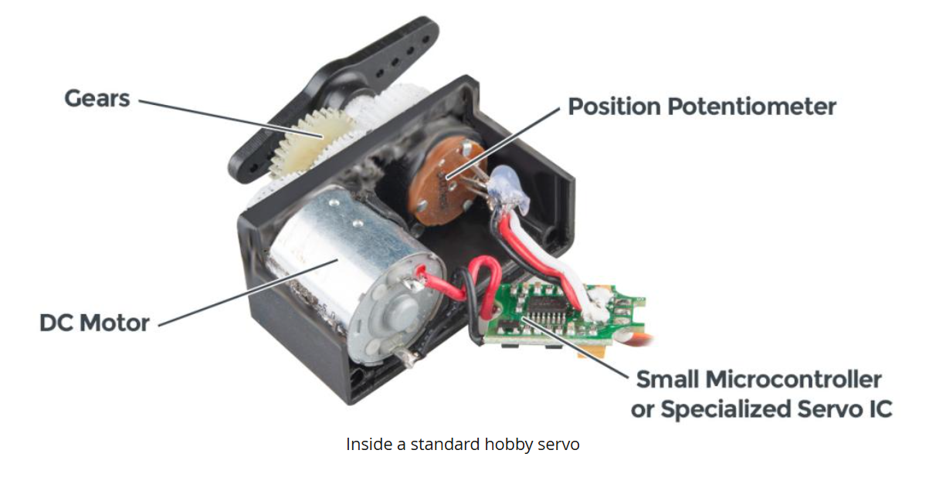

Slide 5
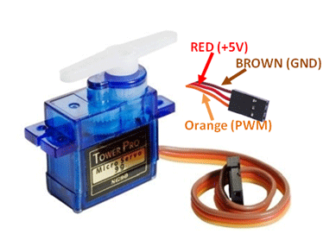
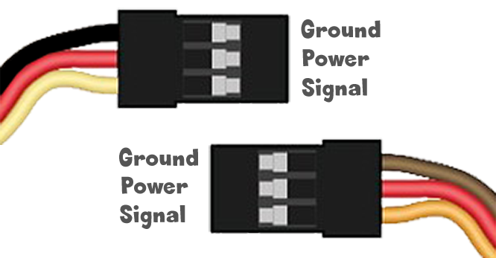
Servo wires

Slide 6
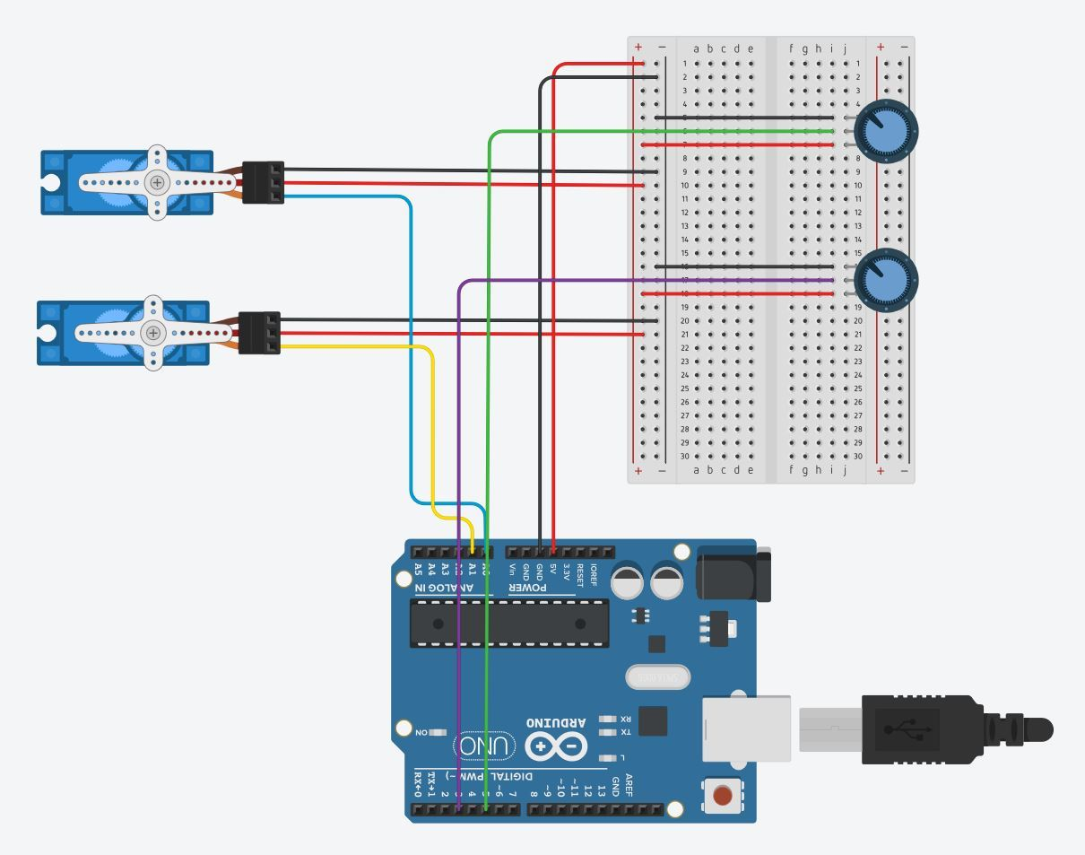
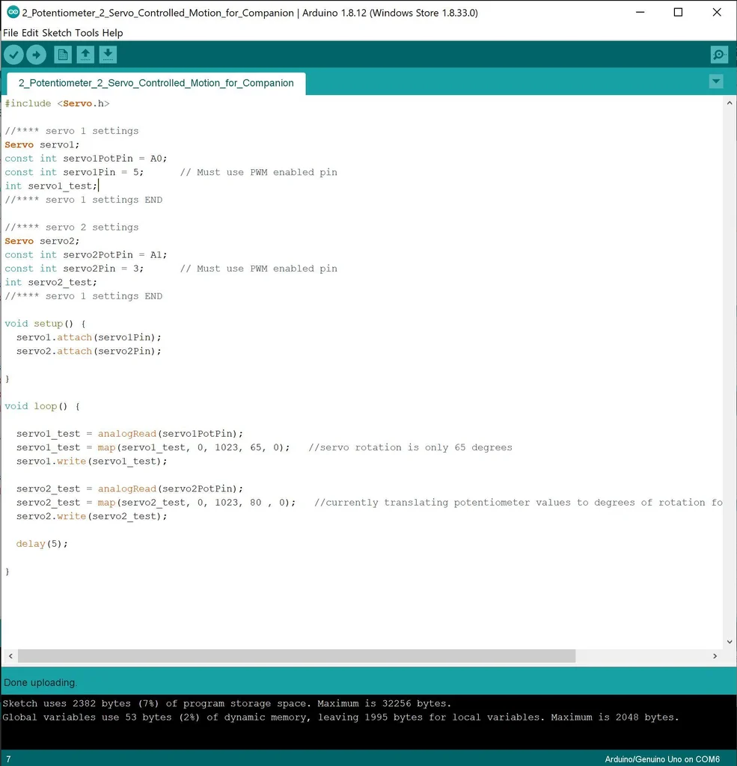
Wiring + Code
Potentiometer-Servo Documentation.docx
Notes:
Potentiometer-Servo Documentation.docx

Slide 8
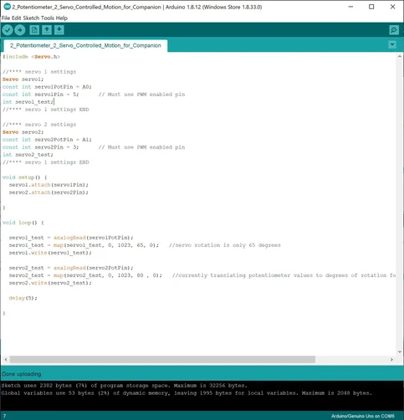
Servos - Arduino Code
Notes:
Servos - Arduino Code

